Slide 1
Machine Learning Project Presentation
By: Thomas Fitzgerald, Vladimir ogloblin, adam seliga

Slide 2
motivation
PROMPT #5: Autonomous Drone Navigation: Design a machine learning algorithm that enables drones to navigate and avoid obstacles autonomously using real time sensor data.

Slide 3
LITERATURE Reference
A Path Planning Algorithm for Collective Monitoring Using Autonomous Drones
Location-based reward function
Goal not in a fixed location

Slide 4
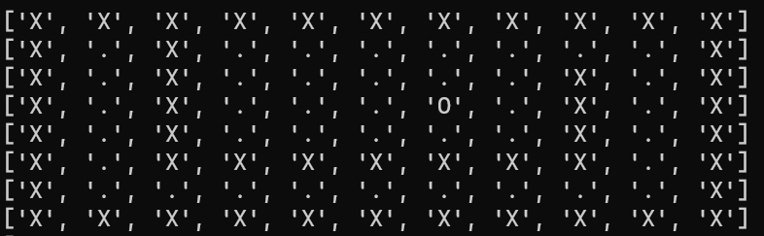
methodologies
Maze Navigation
Determines possible actions based on location
Each possible location is a state
‘X’ – Wall
‘O’ – Goal
‘+’ – Drone
‘.’ – Freespace

Slide 5
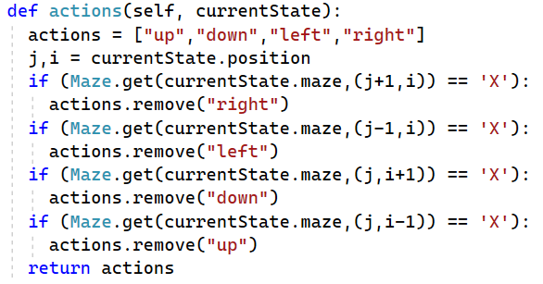
methodologies
State is held in a node
Each node contains list of actions
Child nodes created based on an actions

Slide 6
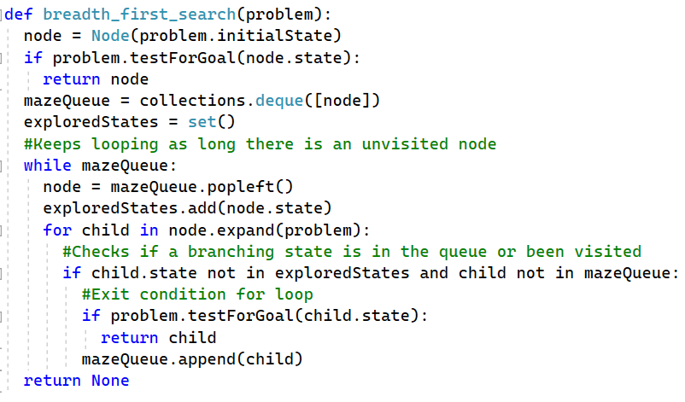
methodologies
Breadth First Search
Testing program works
No cost function

Slide 7
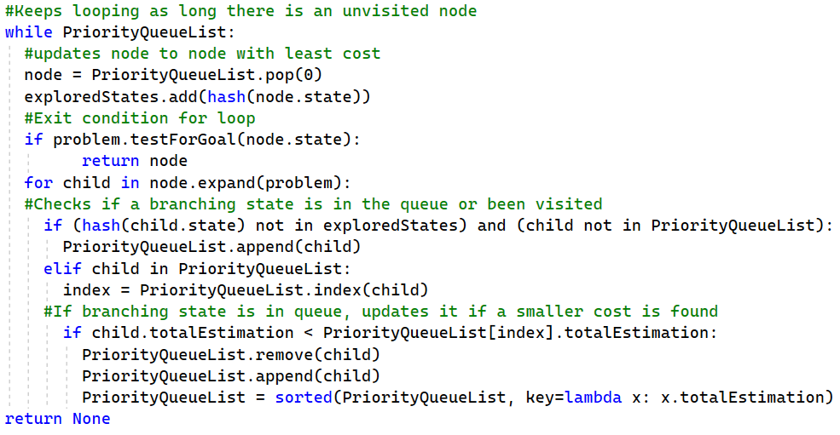
methodologies
A-Star search algorithm
Priority Queue and Visited list
Queue organized by smallest cost
Manhattan Distance
F = G + H
| (Y2 – Y1) + (X2 – X1) |

Slide 8
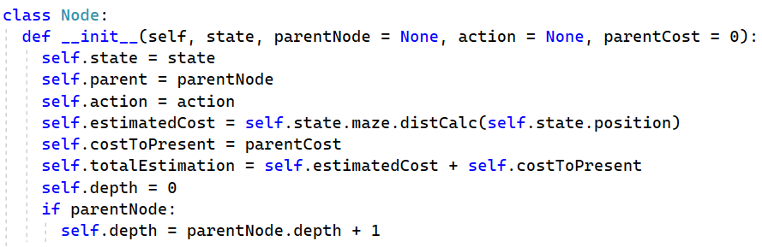
methodologies
Algorithm returns node with goal state
Pathway found through tracing parent

Slide 9
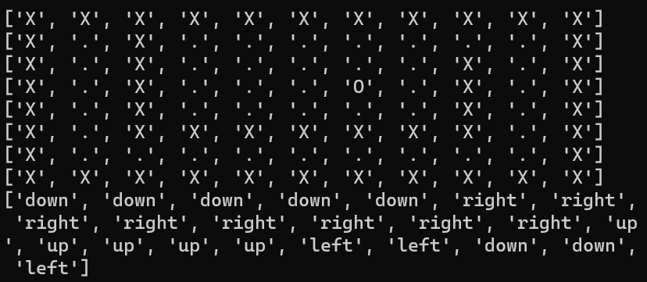
Results
Algorithm prints list of actions taken

Slide 10
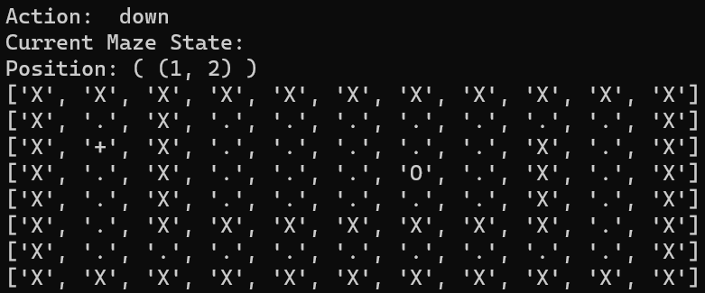
Results
Algorithm then prints the action taken, position, and state for each action taken

Slide 11
Conclusion
Islam, S., &amp; Razi, A. (2019). A path planning algorithm for collective monitoring using autonomous drones. 2019 53rd Annual Conference on Information Sciences and Systems (CISS). https://doi.org/10.1109/ciss.2019.8693023

